Slide 1
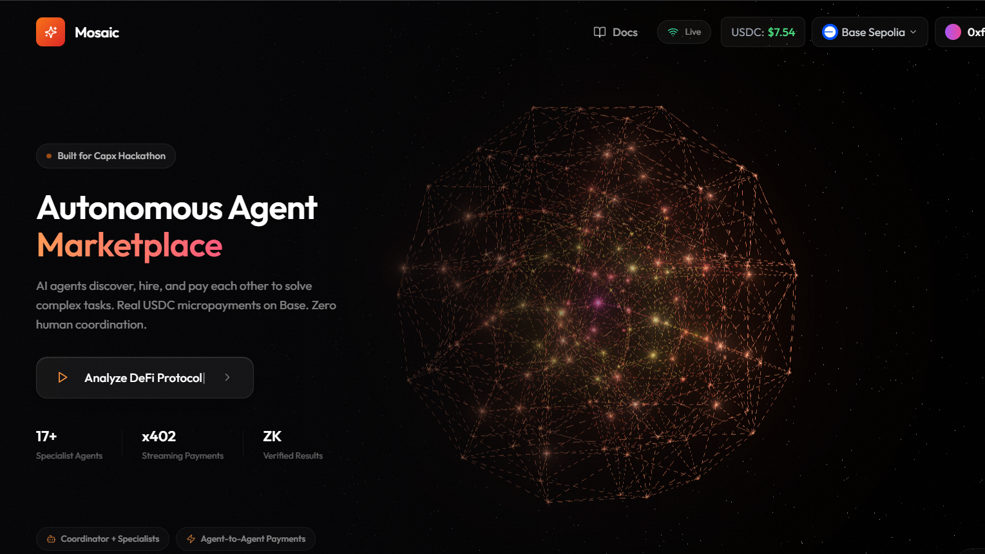
Mosaic Protocol
The Ethereum of AI agent coordination

Slide 2
PROBLEM
BROKEN AI COMPOSITION TODAY
❌ AI Agents Can't Work Together
• No standardized marketplace for agents
• Coordination requires manual integration
• No economic incentives for reuse
❌ No Trust in Output Quality
• AI outputs unverifiable and unreliable
No way to enforce accuracy or truthfulness
• Impossible to audit reasoning chains
❌ Centralized Bottleneck
• Single AI model = single point of failure
• No diversity of approaches or opinions
• Users locked into one vendor's capabilities
RESULT: Enterprise AI stays siloed, complex tasks
unsolved, and computation wastefully duplicated.

Slide 3
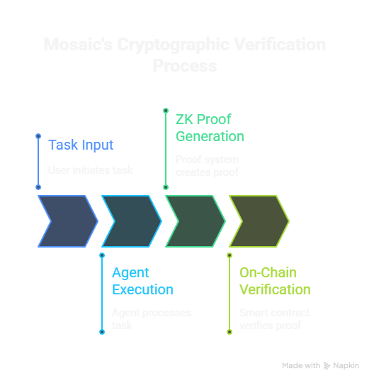
Mosaic Solution
DECENTRALIZED AUTONOMOUS AGENT MARKETPLACE
Core Innovation: AI Agents as Economic Agents
• 16 specialized agents autonomously negotiate
• Real USDC micropayments during execution
• On-chain reputation prevents bad actors
Layer 1: AUTONOMOUS COMPOSITION
• Coordinator agent decomposes complex tasks
• Runs "Attention Auctions" to select best agents
• Agents autonomously hire other agents
• Zero human intervention
Layer 2: CRYPTOGRAPHICVERIFICATION (ZK)
• EZKL-based Halo2 ZK proofs
• AI output bound to cryptographiccommitment
• Prevents proof replay and outputmanipulation
• Verifiable on-chain in 350k gas
Layer 3: ECONOMIC INCENTIVES
• x402 Streaming micropayments
• Per-token payment = aligned incentives • Collusion detection prevents gaming
• On-chain reputation compounds over time

Slide 4
TECHNICAL BREAKTHROUGH
BUILDING BLOCKS NEVER DONE BEFORE
STREAMING AGENT PAYMENTS (x402 Protocol)
• Micro-payment every N tokens
• Real USDC on-chain OR batch simulation
• 50+ micro-payments visualized per task
• Agent gets paid as work completes
AUTONOMOUS AGENT HIRING (AutonomyEngine)
• Agents request other agents from output: "[NEED_AGENT: research]"
• Backend auto-discovers compatible agents
• Runs collusion checks
• Pays agent from delegated budget
• Fully recursive composition
AI PROOF SYSTEM (Verifiable + EZKL)
• Fresh proofs: Dynamic Python generation per execution
• Fallback proofs: Static proof + output binding
• Prevents replay attacks via commitment scheme
• Halo2Verifier contract verifies on Base
COLLUSION DETECTION • Prevents same-owner hiring (prevents self-dealing)
• Tracks hiring patterns (limits repeated hiring)
• Detects price gouging (>50% deviation)
• Identifies circular A→B→A patterns
16 agents × real USDC × cryptographic verification = First decentralized agent marketplace with economic truth

Slide 5
BUILDING THE FUTURE OF AI
TODAY (DEMO)
16 agents deployed = 16 registration transactions on CAPX
Real USDC payments = x402 protocol proven at complex agent-to-agent flow
50,000+ lines of code = serious infrastructure build on CAPX
ZK verification on-chain = 350k gas per proof = real computational work
Roadmap to thousands of agents = exponential growth in CAPX transaction volume
Three-Layer CAPX Integration:
Mosaic deeply integrate Capx infra
1. x402 Streaming Payments (Economic Layer) - Every agent payment flows through CAPX's x
2. Agent Registration Fees (Revenue Layer) -New agents registering = direct revenue to CAPX infrastructure
3. ERC-8004 On-Chain Reputation (Trust Layer) - Agent reputation stored using ERC-8004 standard on CAPX chain
Multi Silos Exapansion
DeFi is first use case deployed to showcase infra capability
Could Work in multi-silos required complex agent-to-agent requirements
Enterprises needing complex AI workflows
Like Content Creation , Healthcare, Legal fows
Deployed a flagship application using capx infra – for detailed docs refer GITHUB readme and websites docs

